Slide 1
Cyber Sentinel
Dynamic Threat Analysis and Prediction Dashboard

Slide 2
PROBLEM STATEMENT:
Predicting and Forecasting Threats/Cyber Attacks [Cyber Security Theme]
Analyze the current and historical data which is available publicly and predict future Threats or Cyber Attacks and impact on any firm using web scrapping. Example: systems going down during Black Friday, Data Leakage Thefts, location impact on sites due to some riots etc.

Slide 3
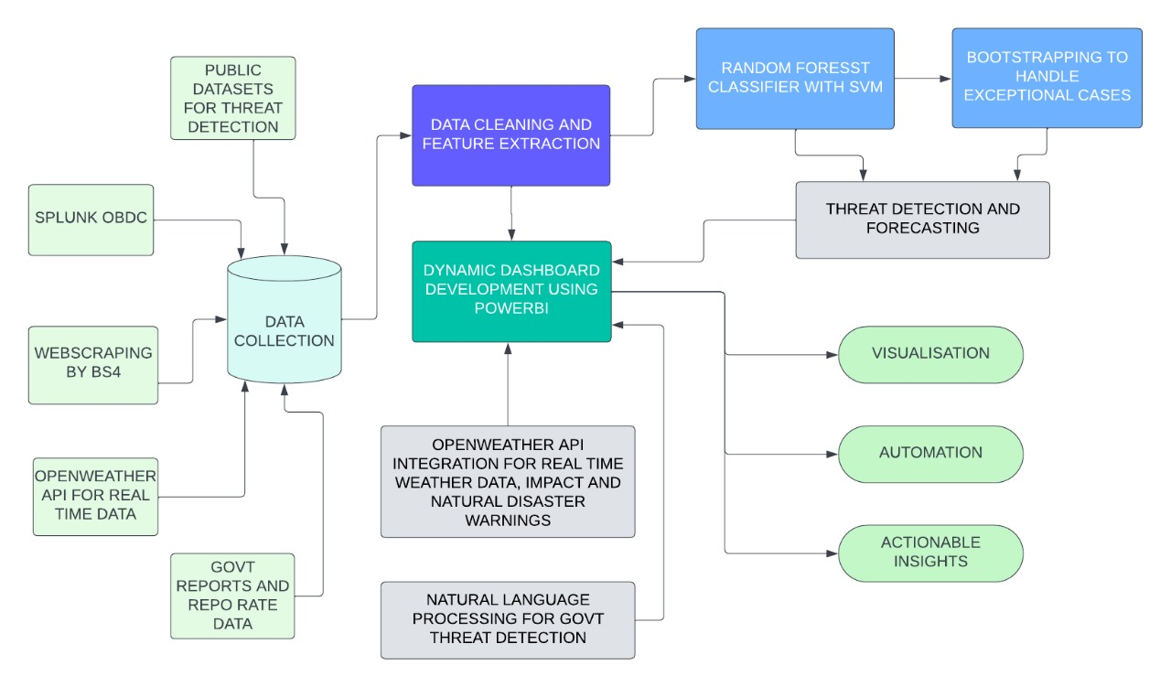
ARCHITECTURE DIAGRAM:
Tech stack:
Python
SQL
Power BI
OpenWeather API
Twitter API
Clicksend api
Bitdefender API

Slide 4
RESULTS

Slide 5
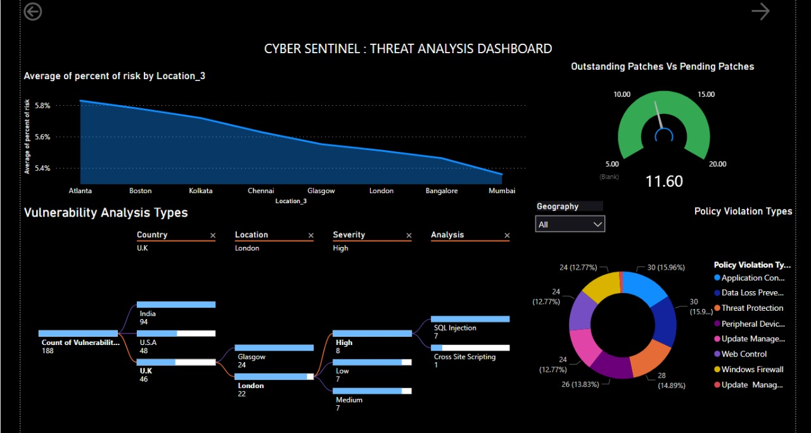

Slide 6
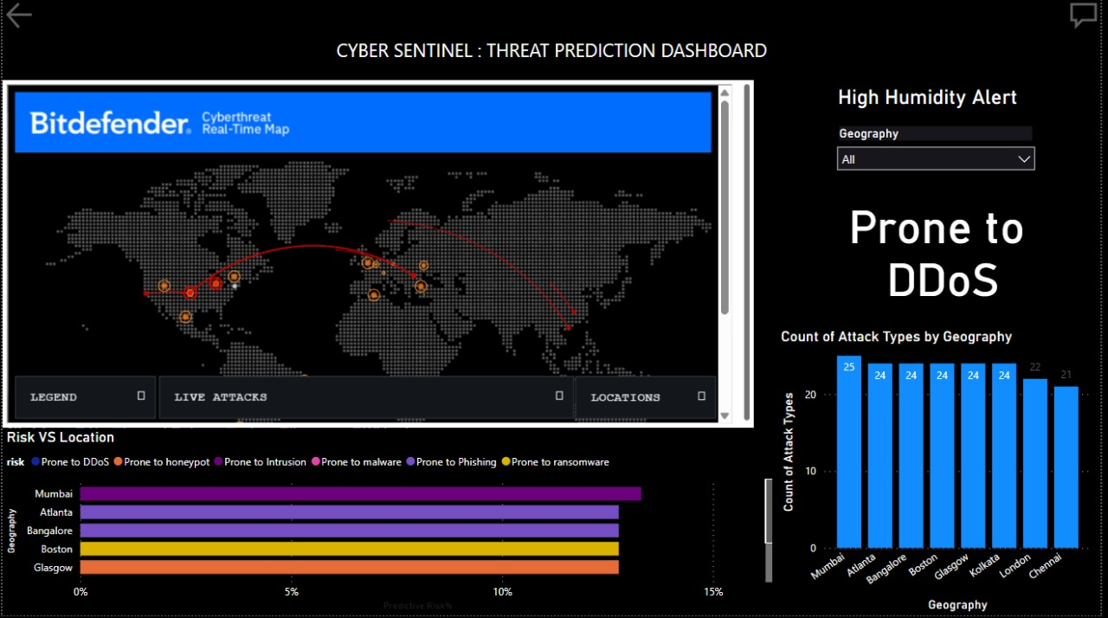

Slide 7
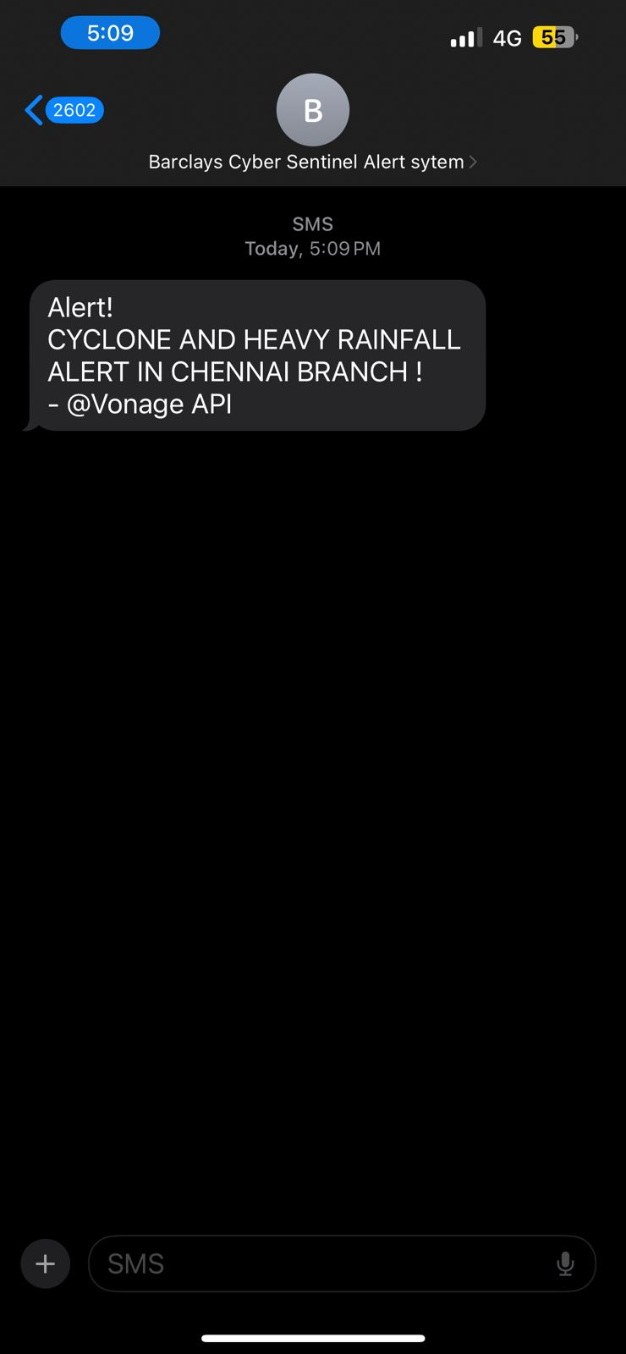
SMS DESIGN
On detecting harsh weather conditions, we have also implemented the use of an SMS system which will be sending out threat alerts to all those who are predicted to be affected by it

Slide 8
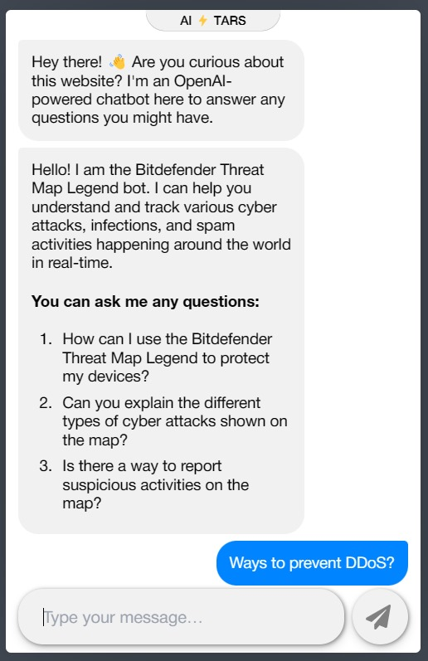
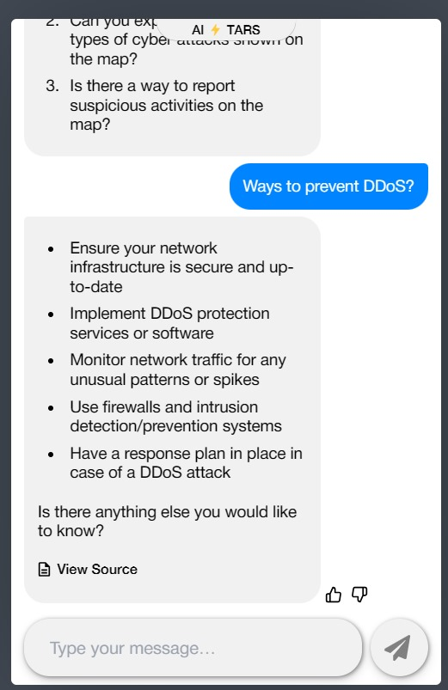
To further engage and aid our clients , we have also used a chatbot to advise clients on how can they prevent or recover themselves from a cyber attack

Slide 9
THANK YOU
-TEAM CYBER ORIONS

